Slide 1

Accessing Google Classroom in Gilnahirk Primary School

Slide 2
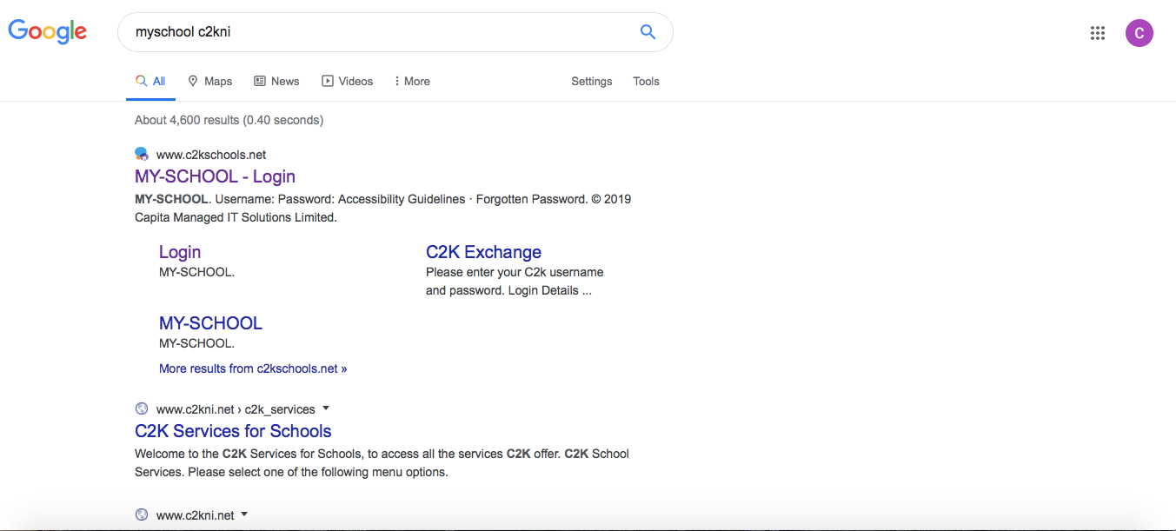
Type “my school c2kni” into Google and click the link to www.c2kschools.net.

Slide 3
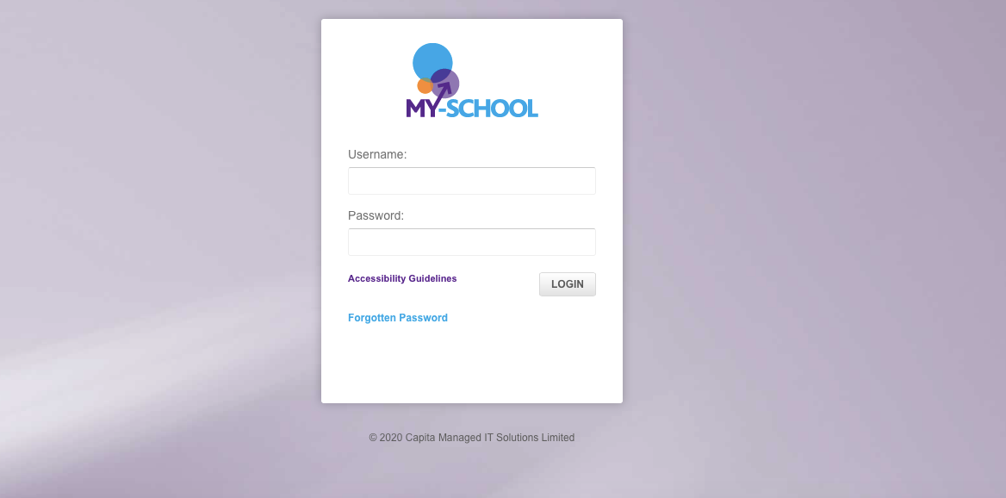
Type your child’s username and password into the boxes provided. You will have received these home from your child’s teacher.
Eg: jbloggs345

Slide 4
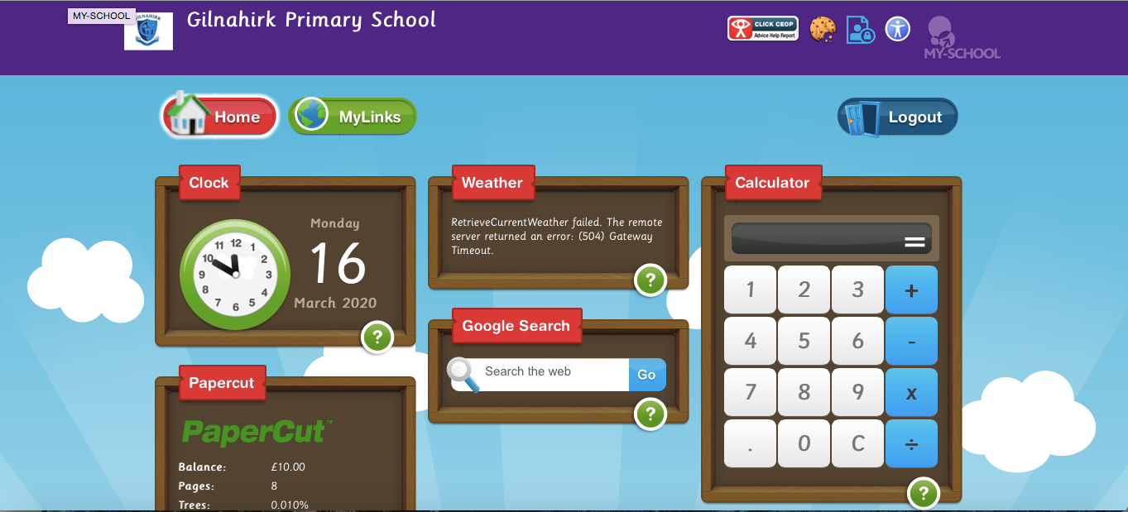
Now click on the ‘My Links’ tab.

Slide 5
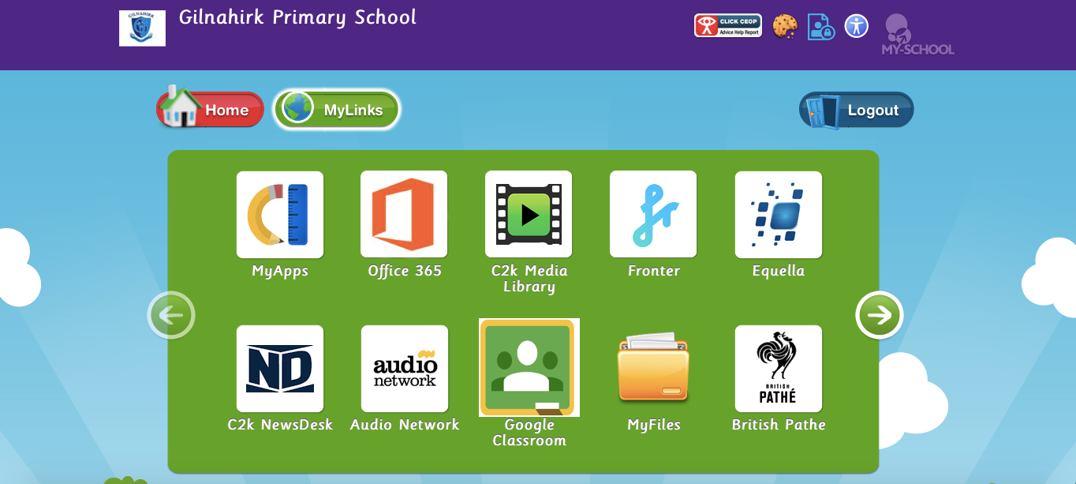
Click on the Google Classroom tab (be aware that you may need to scroll using the arrows at each side to find Google Classroom)

Slide 6
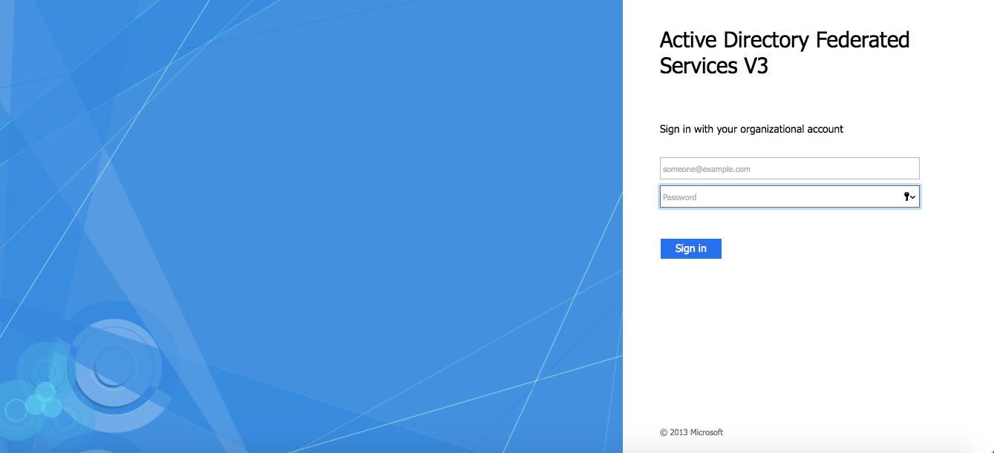

Slide 7
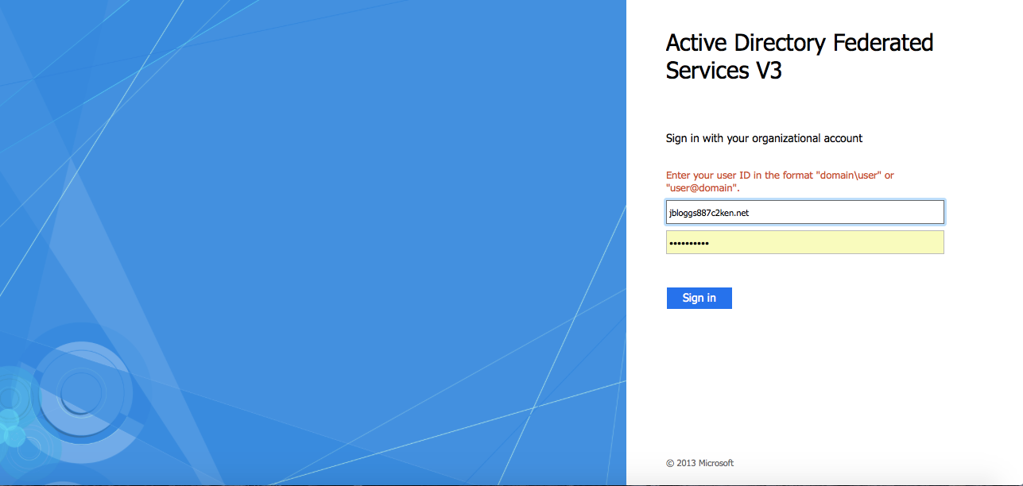
Using the same user name and password you used to access My School
Type in your child’s C2k username adding @c2ken.net after the number

Slide 8
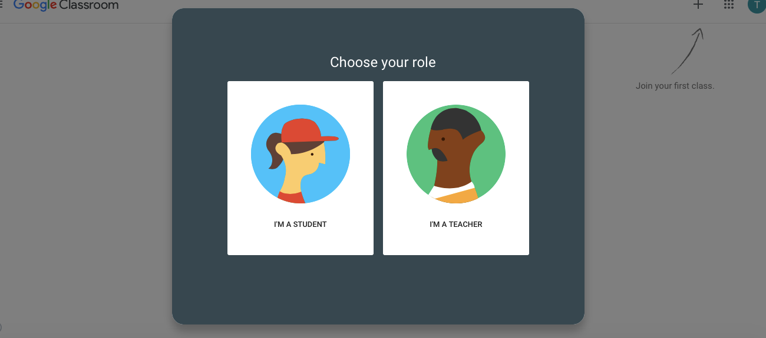
Select- I’m a Student.

Slide 9
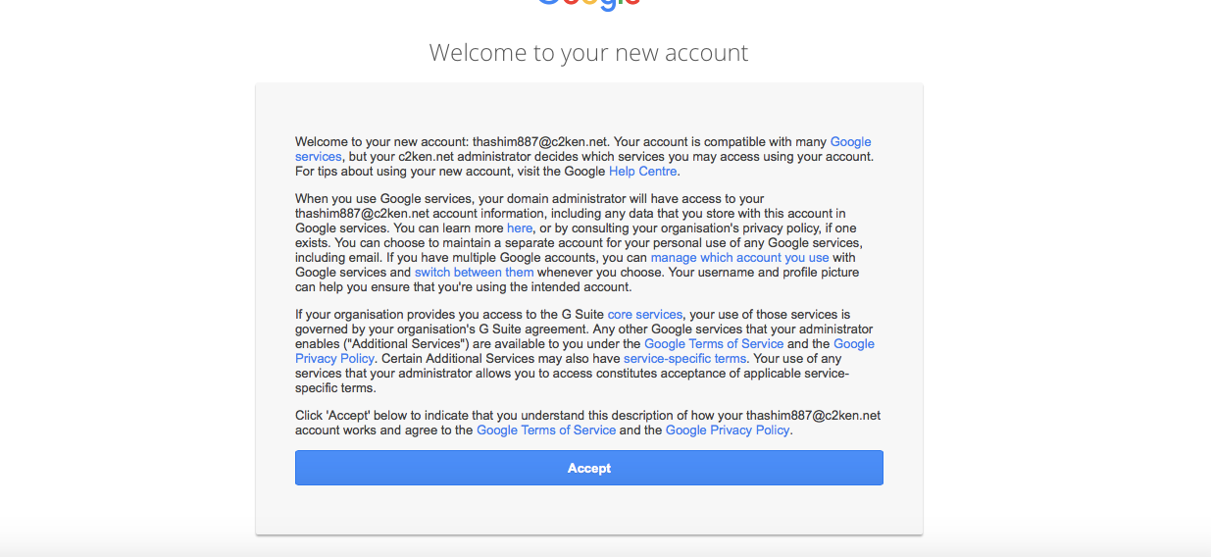
Click the Accept tab.

Slide 10
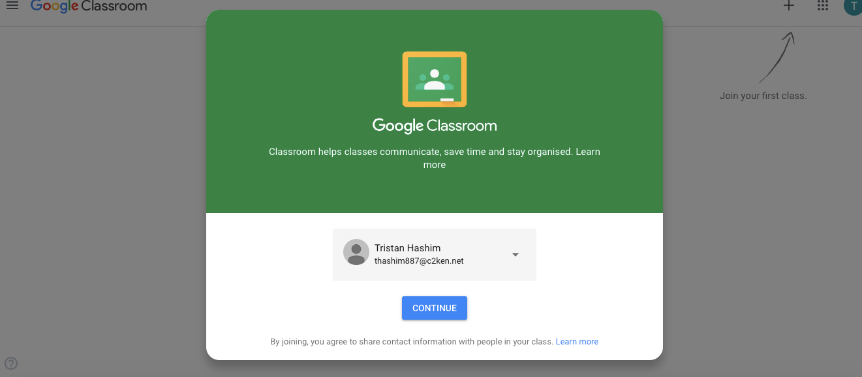

Your child’s username will show up in this box. Click Continue.

Slide 11
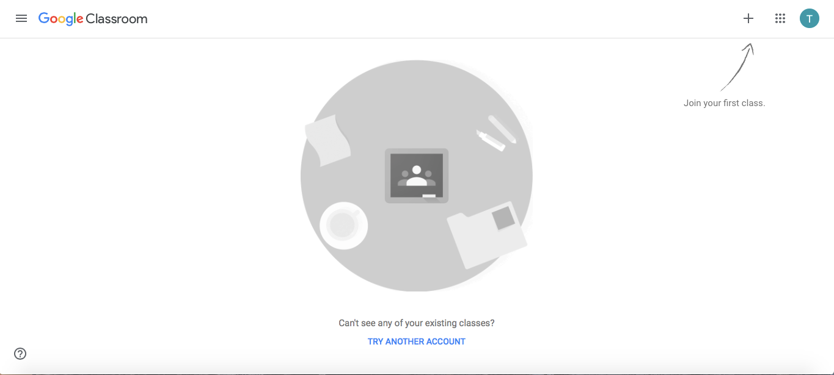
Click the ‘+’ symbol at the top right-hand corner where it says “Join your first class”

Slide 12
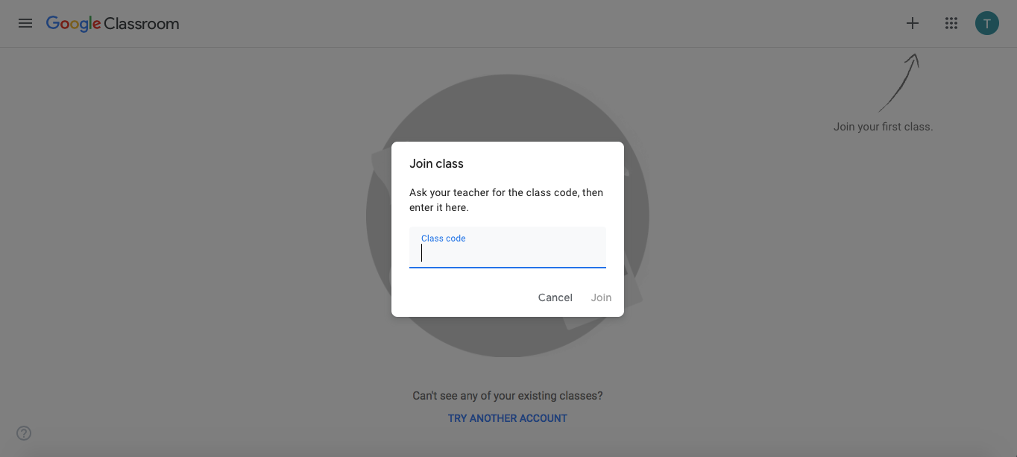
Type in the Class Code supplied by your child’s teacher then click join.
Quick Tip
Try downloading the Google Classroom App for faster access.

